Slide 1
https://github.com/marianosz/netCoreWorkshop

Slide 2
.NET Core Workshop
Mariano Sánchez
Software Architect

Slide 3





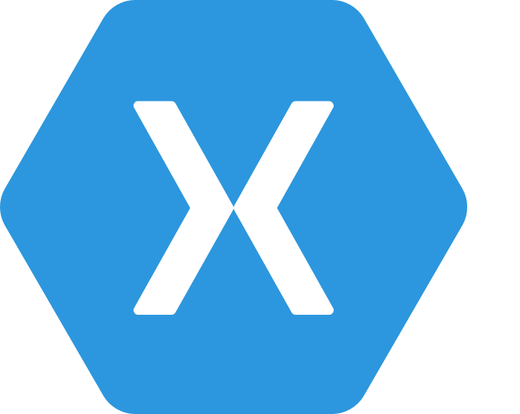
.NET Any developer, any app, any platform
OS X
iOS
Notes:
No better time to be a .NET developer – you have more scenarios at your finger tips than ever, using the technology you love and make you productive. You can literally build any app for any device for any platform with .NET.

Slide 4
.NET today—the family gets bigger
.NET FRAMEWORK
.NET CORE
XAMARIN
Platform for .NET applications on Windows
Cross-platform and open source framework optimized for modern app needs and developer workflows
Cross-platform and open source Mono-based runtime for iOS, OS X, and Android devices
Distributed with Windows
Distributed with app
Distributed with app
Notes:
Notes: Focus on the great additions to the .NET Framework, enabling developers to target the latest applications in the cloud and devices. Explain the distribution mechanism of each. .NET Framework is distributed and available on Windows whereas .NET Core & Xamarin are distributed with the app.

Slide 5
.NET today—app models and libraries
.NET FRAMEWORK
.NET CORE
XAMARIN
APP
MODELS
WPF
Windows Forms
UWP
iOS
Android
ASP.NET
ASP.NET Core
OS X
BASE
LIBRARIES
Base Class Library
Core Library
Mono Class Library
COMMON INFRASTRUCTURE
Compilers
Languages
Runtime components
Notes:
Notes: Even if we are reusing a lot across components (especially with the open sourcing last year), the reality is that each platform has its own implementation of the base libraries.
Note: .NET Framework BCL and Mono BCL are the same APIs, different implementation. .NET Core “Core Library” is a similar set of APIs, but different.

Slide 6
.NET today—reusing code
CHALLENGES
Difficult to reuse skills
Need to master 3+1 base class libraries
Difficult to reuse code
Need to target a small common denominator
Difficult to innovate
Need implementations on each platform
Implementation 3
Implementation 2
Implementation 1

Slide 7
.NET tomorrow
.NET FRAMEWORK
.NET CORE
XAMARIN
WPF
Windows Forms
UWP
iOS
Android
ASP.NET
ASP.NET Core
OS X
.NET STANDARD LIBRARY
One library to rule them all
COMMON INFRASTRUCTURE
Compilers
Languages
Runtime components
Notes:
Notes: Please welcome the .NET Standard Library [explain details]
As we move into the future we want to make it much easier for .NET developers to write their code once and be able to execute across .NET implementations, whether that’s .NET Framework, .NET Core, or Mono/Xamarin. To this end, we will continue to evolve and expand the .NET Standard into a set of APIs that are shared broadly across frameworks and application models. This will provide our ecosystem with much more explosive growth with libraries that can shared much more easily.

Slide 8
.NET tomorrow—reusing code
BENEFITS
Reuse skills
Master one library, not a platform
Reuse code
Big surface area - no small common denominator
Faster innovation
.NET Standard can grow without updating platforms
Reference implementations
Full implementations
Notes:
Notes: Reusing code is dramatically better with the .NET Standard Library. It includes reference implementations, just like the PCL but it also can be extended with full implementations shared across all platforms.

Slide 9
.NET Runtimes
Full .NET CLR
Includes all APIS, and ensures backward compatibility.
.NET Core
Small (11 MB)
Composable, distributed via NuGET
Side by Side
Cross-Platform
Windows, OS X, Linux
Ryujit y .NET GC OSS

Slide 10
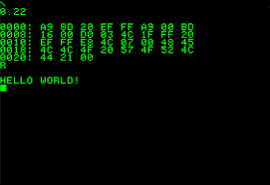



.NET Core

Slide 11
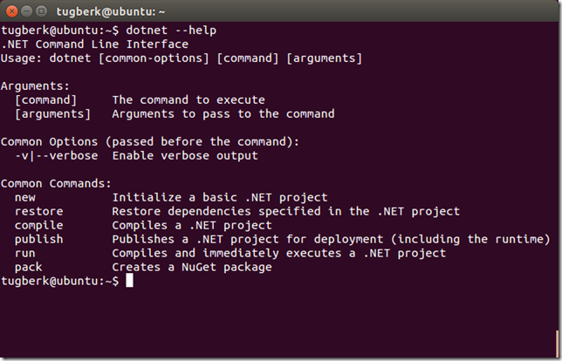
.NET Command Line Interface (CLI)
A single tool for compiling, deploying, and managing .NET applications on all platforms
Notes:
The .NET Execution Environment (DNX) is a software development kit (SDK) and runtime environment that has everything you need to build and run .NET applications for Windows, Mac and Linux. It provides a host process, CLR hosting logic and managed entry point discovery. DNX was built for running cross-platform ASP.NET Web applications, but it can run other types of .NET applications, too, such as cross-platform console apps

Slide 12
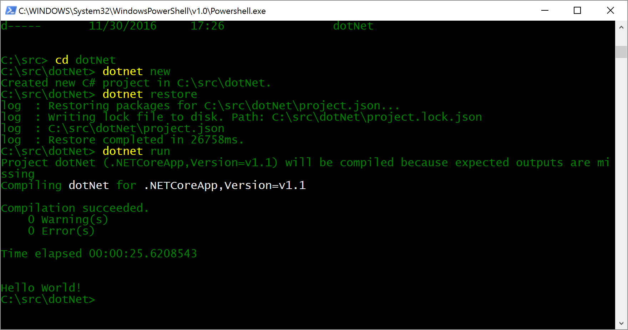
Running a .NET application
dotnet run

Slide 13
Demo

Slide 14
Installing .NET Core
Compiling
https://github.com/dotnet/coreclr
Using Command Line
http://dot.net
Using the installer
http://dot.net

Slide 15
Languages
C#
Flexible, powerful, multi-purpose
Investments in C# 7: Evolve for modern patterns in distributed applications: tuples, pattern matching, others.
VB
Simple, easy to use
Investments in VB 15: Bring key language features and platforms while keeping VB simplicity principles.
F#
Elegant functional programming
Investments in vNext: Language updates for C# 7 / VB 15 interop, platform support and tooling updates.
Notes:
C#, Visual Basic and F# are all supported on .NET Core and can be used to create cross-platform apps that run anywhere. In addition, C# is supported in other cross-platform editors like Visual Studio Code via OmniSharp. Currently there are project templates provided C# in Visual Studio and Visual Basic templates will be added as the tooling reaches RTM (with Visual Studio NEXT).

Slide 16
Development Tools
Visual Studio 2017
Visual Stuido
Visual Studio Code
Visual Studio Code
Other editors: Sublime Text, Atom, etc.
Other editors: Vi, Emacs, Atom, etc.
Visual Studio Code

Slide 17
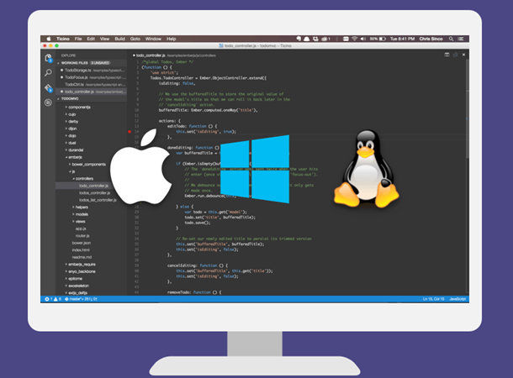

Visual Studio Code
Lightweight, cross-platform editor for Windows, OS X and Linux
Whit IntelliSense, colors, refactoring, etc.
Local editing, compilation, execution and debugging

Slide 18
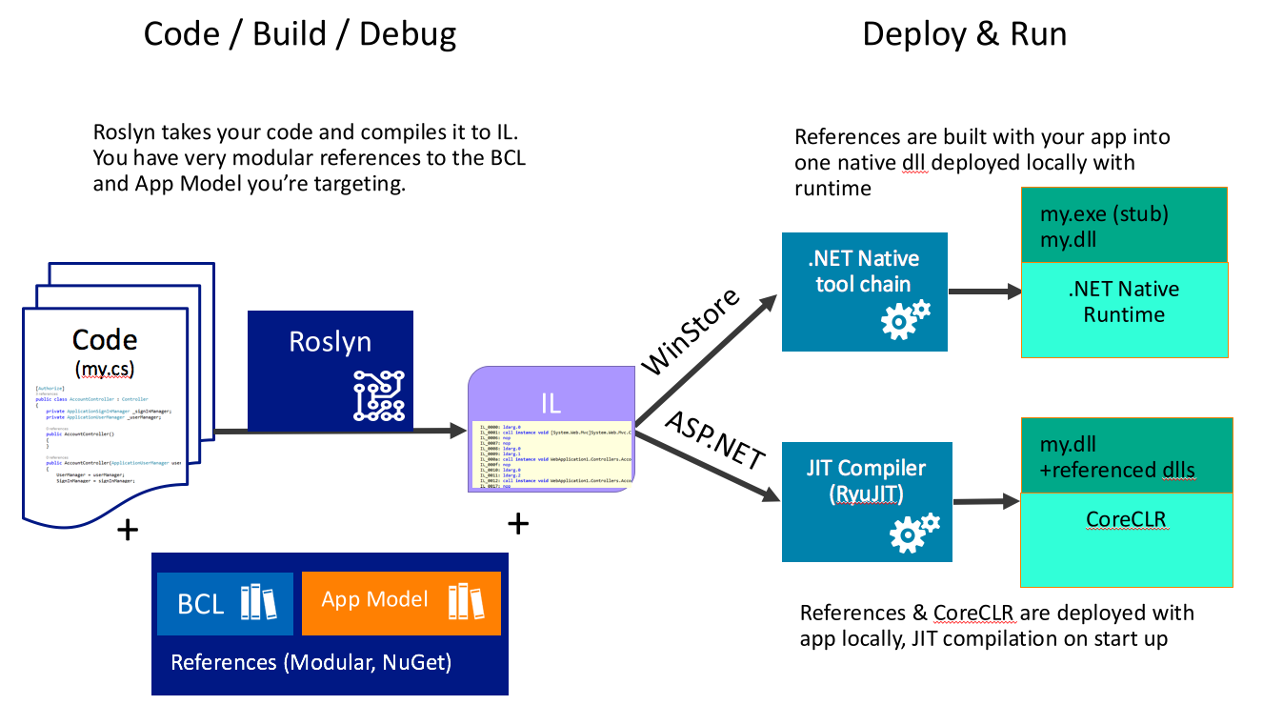

Slide 19
ASP.NET CORE

Slide 20


ASP.NET Core and the modern web
Totally modular
Faster development cycle
Seamless transition from on-premises to cloud
Choose your editors and tool
Open source with contributions
OSS
Cross-platform
Fast

Slide 21


ASP.NET in a Nutshell
C#
Web
Forms
MVC 5.x
Web API 2.2
MVC / Web API 6
ASP.NET 4.6 System.Web
ASP.NET Core
Core CLR
.Net Native
.NET Framework 4.6
.NET Core
Full .NET Framework for any scenario and
library support on Windows
Modular libraries & runtime optimized for server and cloud workloads

Slide 22
ASP.NET Core Stack
ASP.NET
Web API
MVC
Web Pages
Middleware
.NET CLR
.NET Core CLR
Host
IIS
Self-hosted
OS

Slide 23
Models, Views, and Controllers
What does MVC look like?
Request
Controller

Model

Response
View

Notes:
20486A
01: Exploring ASP.NET MVC 4

Slide 24
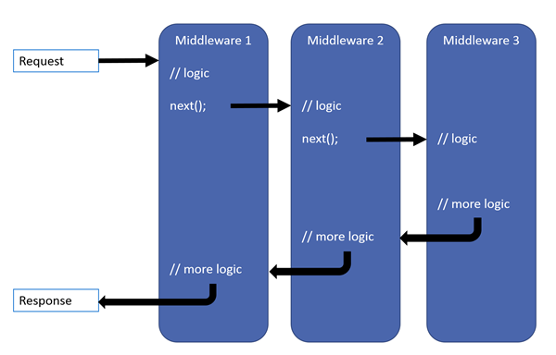
Middleware

Slide 25
Demo

Slide 26
¿Preguntas?

Slide 27
A trabajar!!
Mariano Sánchez
sanchezmariano@outlook.com
@marianosz
http://weblogs.asp.net/marianos

